Slide 1
Bank customer churn prediction

Slide 2
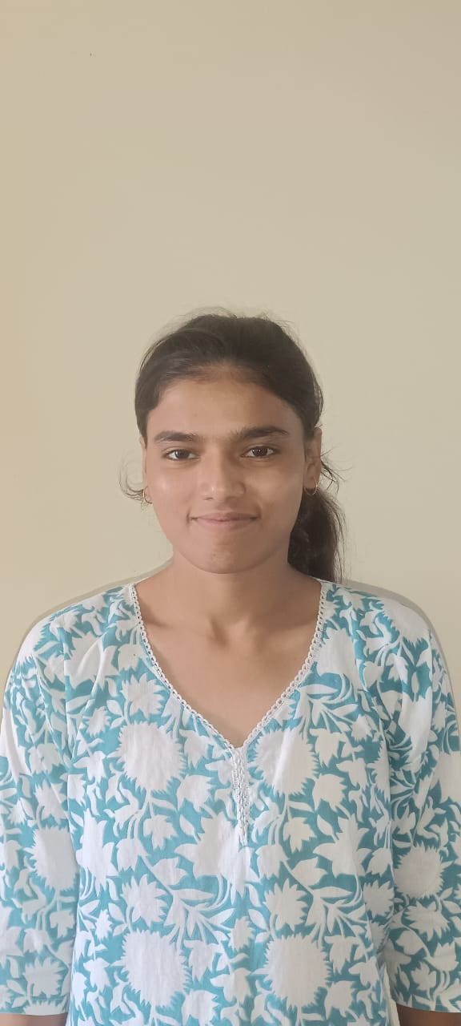
The Team
Ashi
Kashish Gautam
Bhoomi
Student Name
AB
Khushi

Slide 3
Workload Division
Contribution of each team member in project
Bhoomi:- Machine Learning Support, Web Development, Data Visualization, Video Demonstration
Kashish Gautam:- Data Handling, Reprocessing, Documentation, Presentation
Ashi:- Core development, web application, ML Integration, Visualization.
Khushi:- Documentation and Reporting

Slide 4
The Background
Customer churn is a major challenge in the banking industry and sector.Losing customers leads to significant revenue loss. Traditional systems are reactive and not predicative Backs lack tools to identify at risk customers early. Banks often fail to identify customers who are at risk of leaving before is to late. Therefore there is a strong need for an intelligent AI-driven system that can predict customer churn in a advance and help organizations take preventive actions.

Slide 5
Proposed Solution
The proposed solution is to develop a machine learning–based predictive model to identify customers who are likely to churn.
The model is trained on historical banking data, including customer demographics and account-related information.
An AI –powered web application for churn prediction. Uses machine learning to analyze customer data. Predicts whether a customer will leave or stay
Provides churn probability and risk level. Suggests retention strategies for decision making.

Slide 6
Solution Design
System Architecture:
Frontend: Streamlit (Interactive UI)
Backend: Python
Machine Learning Model: Scikit-learn
Data Processing: Pandas & Numpy
Visualization: Plotly
Working Flow:
1.User Login
2.Input Customer Data/ upload CSV
3.Data Preprocessing (Encoding + Scaling)
4. Model Prediction
5. Dashboard Output (Risk + Insights)

Slide 7
Technology Stack & Requirements
)
Technology Stack:
Python
Pandas, NumPy
Scikit-learn (Random Forest, StandardScaler)
Matplotlib, Seaborn, Plotly
Streamlit
Pickle (model storage)
JSON (user authentication)
OS module (file handling)
Requirements:
Python 3.x environment with required libraries installed
Bank customer dataset (Churn_Modelling.csv)
Trained model files (model.pkl, scaler.pkl)
Basic system configuration (minimum 4GB RAM)
JSON file: users.json

Slide 8

Innovative Idea
Integration of a machine learning–based churn prediction model with an interactive Streamlit dashboard for real-time analysis.
Dual functionality: single customer prediction and bulk prediction using CSV upload for large-scale analysis.
Real time churn prediction system AI- based retention strategy suggestions Interactive and dynamic dashboard Combines AI with business intelligence
Dual Functionality:
Single Customer analysis
Bulk CSV analysis

Slide 9
Results / Outcomes / Analysis
The machine learning model successfully predicts customer churn with good accuracy.
Key factors influencing churn include age, balance, credit score, and activity status Enables targeted making actions.
The Streamlit application provides real-time predictions and interactive visualizations. Improves customer retention strategies.
Identifies high-risk customers in advance provides probability- based decision support Helps in recuing customer churn.
The system helps in making data-driven decisions for customer retention strategies.
Model Accuracy: Approximately: 85 - 86%

Slide 10

Limitations
The model is trained on a limited and static dataset, which may not fully represent real-world banking scenarios.
Model performance depends on training data quality limited number of input features no real time database integration.
Basic authentication system (JSON-based) some dashboards use synthetic (random) data.
The current system also uses a basic authentication mechanism and is not deployed on a scalable cloud environment, limiting its use in large-scale applications.

Slide 11

Future Enhancements/Scope
Integrate real-time data such as transaction history and customer
activity for improved prediction accuracy.
Deploy the application on cloud platforms (AWS, Azure) for
scalability and real-world usage use of advanced ML models (XGBoost ,deep learning) .
Implement a more secure authentication system with encryption
and database integration.explainable AI for better transparency
Add personalized recommendation systems for targeted customer retention strategies enhanced security (encryption,
JWT authentication).
Enhance the user interface with more advanced analytics and dashboards Personalized customer recommendation System.

Slide 12
https://github.com/AshiSingh15/Bank-Customer-Churn-Prediction

Slide 13
Thank You

